Slide 1
Non-Linear classification
Chunyang wei

Slide 2
Review
Notes:
KNN??
NN??

Slide 3
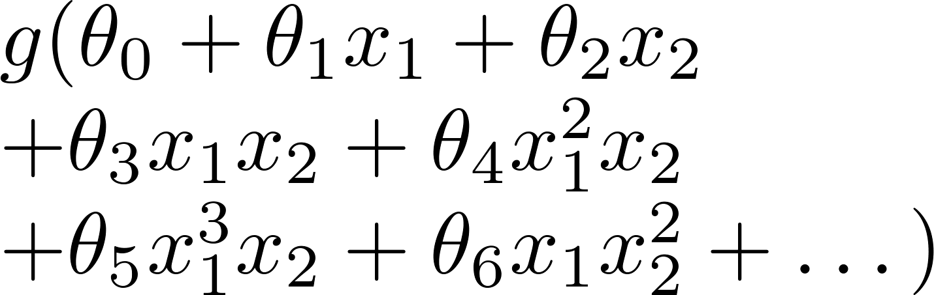
Non-linear classification
x₂
x₁
Today’s outline
Decision Tree
Random Forest
Neural Network
K-NN

Slide 4
Decision Tree

Slide 5
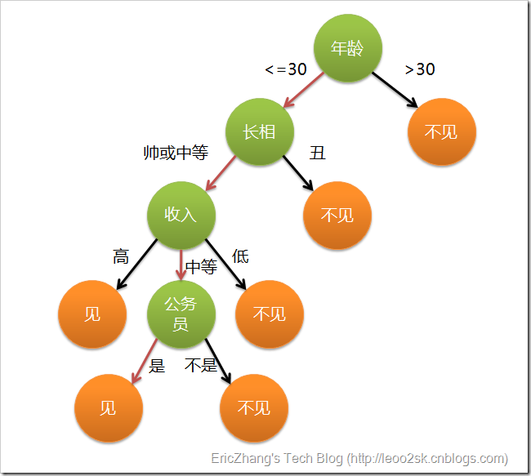
Basic Idea
“If-else Rule”
Classical Algorithm:
ID3,C4.5,CART

Slide 6
How to build the Tree
Top-down recursive procedure
Greedy Search
Main loop:
1. Select a feature F best classifies examples
2. Create a node using F, separate the data set with different values of F
3. Recursively build sub-tree
4. Stop until:
The examples have the same category: build a leaf node with this category
The feature set is empty: build a leaf node with the most common category
ID3 Algorithm
Notes:
画一颗示意过程的树动画

Slide 7
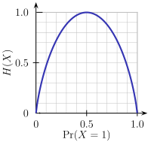
Feature Selection
Pick a feature that has the best classification ability.
Creates subsets of examples that are relatively “pure” in a single class.
Information Gain
Entropy
Gain(X,A) = expected reduction in entropy due to spliting on A
Notes:
熵表示随机变量的不确定性，熵越大，随机变量的不确定性越大。
熵表示了编码有这样概率分布的样本，需要的最少平均每个样本的bit是多少
如果所有样本都属于同一个分类，熵为0.
信息增益表示的值特征A的信息而使得D的不确定性的减少程度。
其中H(D|A)称为条件熵，表示在已知A的情况下，随机变量D的不确定性
H(D)=-\sum_{i=1}^n{p_i\log{p_i}}
Gain(D,A)&=H(D)-H(D|A)\\
&=H(D)-\sum_{v\in Values(A)}{\frac{|D_v|}{|D|}H(D_v)}

Slide 8
C4.5
Use Gain Ratio to select feature
Notes:
C4.5克服了ID3用信息增益选择属性时偏向选择取值多的属性的不足
那些取值比较均匀的Feature的splitInfo比较大，信息增益比比较小
GainRatio(D,A)=\frac{Gain(D,A)}{SplitInformation(D,A)}
SplitInformation(D,A)=-\sum_{i=1}^n{\frac{|D_i|}{|D|}\log\frac{|D_i|}{|D|}}

Slide 9
CART

Slide 10
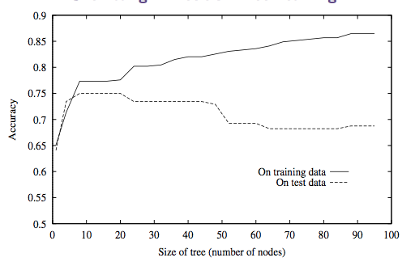
Overfitting
Solution:
Pre-pruning: stop growing when data split not statistically significant
Post-pruning: grow the full tree, then remove subtrees that do not have sufficient evidence
Notes:
如果我们每一个属性都仔细的考虑，理论上可以得到100%拟合训练数据的决策树模型。
但是随着树的复杂度变高，在training dataset上的精确度碧昂高，但是测试数据上的精确度变低，而我们真实的目的是提高测试数据上的性能。
解决决策树的overfitting问题，主要是剪枝 策略，以降低树的复杂度。
一种是pre-pruning, 一种是post-pruning
From wiki:剪枝是决策树停止分支的方法之一，剪枝有分预先剪枝和后剪枝两种。预先剪枝是在树的生长过程中设定一个指标，当达到该指标时就停止生长，这样做容易产生“视界局限”，就是一旦停止分支，使得节点N成为叶节点，就断绝了其后继节点进行“好”的分支操作的任何可能性。不严格的说这会已停止的分支会误导学习算法，导致产生的树不纯度降差最大的地方过分靠近根节点。后剪枝中树首先要充分生长，直到叶节点都有最小的不纯度值为止，因而可以克服“视界局限”。然后对所有相邻的成对叶节点考虑是否消去它们，如果消去能引起令人满意的不纯度增长，那么执行消去，并令它们的公共父节点成为新的叶节点。这种“合并”叶节点的做法和节点分支的过程恰好相反，经过剪枝后叶节点常常会分布在很宽的层次上，树也变得非平衡。后剪枝技术的优点是克服了“视界局限”效应，而且无需保留部分样本用于交叉验证，所以可以充分利用全部训练集的信息。但后剪枝的计算量代价比预剪枝方法大得多，特别是在大样本集中，不过对于小样本的情况，后剪枝方法还是优于预剪枝方法的。

Slide 11
Post-pruning
Separate into training and validation dataset
For each subtree, if prune performs better in validation, then prune it
Avoid wasting of training data:
Do the process above, and record the average pruning subtree complexity C
Train on the whole training data, and prune when subtree complexity reaches C
Notes:
子树的剪枝，把该内部节点用叶节点代替，并且用该节点下类别最多的sample代替这个节点的类别

Slide 12
Pros & cons of decision tree
Pros
“White Box”
Can handle non-linear problem
Easy to implement
Don’t need to do feature transformation (e.g. scaling)
Not much parameter to tune
Easy to parallelized
Cons
Not support incremental update, have to rebuild when new data comes
Not stable
Notes:
Cons: 容易引起overfitting问题，对于这个问题，我们下面讲的random forest可以很好的解决这个问题，可以很好的利用dt的低bias，高variance的特点

Slide 13
Random forest

Slide 14
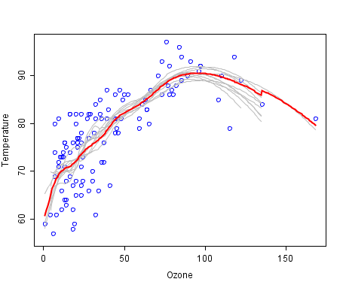
Ensemble Weak classifier
Notes:
后面我们会详细讲到model ensemble。他的大概的思想是，把一些弱的分类器，进行组合，就可以变成相对较强的分类器。尤其针对那些bias比较高，但是variance比较低的模型，这里我们刚刚学习出来的dt就是一个很好的弱分类器。
这张图是什么意思呢，这些灰线是我们学习出来的一些弱模型，可以看到哪一条的结果都没有特别好，但是把他们组合到一起，变成红线，

Slide 15
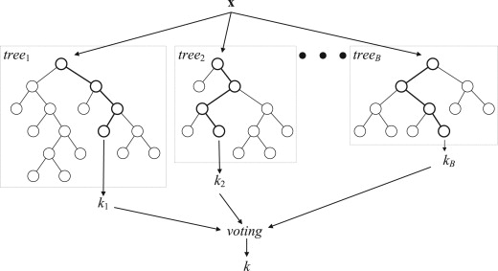
Random forest
Notes:
random forest的思想很简单，就是用dt当做弱分类器，最后组合成一个强分类器。
我们学习出一组dt，当来了新的sample之后，把各个dt预测出的结果进行一下voting。
具体怎么学习这些dt呢，下面我们来讲一下：

Slide 16
Training
Two random selection：
Randomly select samples
Randomly select features
Input: Trainset (size is N), Tree count (T), Feature count(m)
Algorithm:
For building each tree:
1. Random draw N samples with replacement
2. For each node of the tree, randomly choose m features.
3. Calculate the best split based on these m features
4. No pruning
Notes:
在有放回的抽样中，大概

Slide 17
OOB error esitmate
In random forests, there is no need for cross-validation or a separate test set to get an unbiased estimate of the test set error. It is estimated internally, during the run, as follows:
Each tree is constructed using a different bootstrap sample from the original data. About one-third of the cases are left out of the bootstrap sample and not used in the construction of the kth tree.
Put each case left out in the construction of the kth tree down the kth tree to get a classification. In this way, a test set classification is obtained for each case in about one-third of the trees. At the end of the run, take j to be the class that got most of the votes every time case n was oob. The proportion of times that j is not equal to the true class of n averaged over all cases is the oob error estimate. This has proven to be unbiased in many tests.
Notes:
OOB：在构造单棵决策树时我们只是随机有放回的抽取了N个样例，所以可以用没有抽取到的样例来测试这棵决策树的分类准确性，这些样例大概占总样例数目的三分之一（作者这么说的，我还不知道理论上是如何出来的，但是可以自己做试验验证）。所以对于每个样例j，都有大约三分之一的决策树（记为SetT（j））在构造时没用到该样例，我们就用这些决策树来对这个样例进行分类。我们对于所有的训练样例j，用SetT（j）中的树组成的森林对其分类，然后看其分类结果和实际的类别是否相等，不相等的样例所占的比例就是OOB错误估计。OOB错误估计被证明是无偏的。

Slide 18
Why Random Forest is Good
Model ensemble:
Every tree is expert in its field
Other advantages:
Can handle non-linear data
Can handle high-dimensional data
After training, can figure out which feature is more important
During training, 无偏估计
No need to pruning
Stable for outlier, missing data, unbalanced data
Easy to implement
Easy to parallelized

Slide 19
Experiments

Slide 20
Neural network

Slide 21
Try to mimic the brain
Was very widely used in 80s and early 90s; popularity diminished in late 90s.
Recently become popular again: deep learning

Slide 22
Neuron
Activation function
Logistic Regression
Sigmoid activation function
Notes:
我们先来看一下一个单独神经元的定义
他又一些输入，以及一个输出，输入中包含一个为+1偏置
看一下下面这个式子。
输出是输入的线性组合，然后经过一个激活函数。
通常这个激活函数取输出值域在0,1之间，通常是S形的函数，我们之前知道这样一个函数，就是sigmoid函数。
我们可以看到当取f为sigmoid时候，这样的一个单元就相当于一个lOgistic regression了
除此之外，也可以选择其他激活函数，例如双曲正切函数。这一讲中我们使用sigmoid函数
h_{w,b}(x)=f(W^Tx)=f(\sum_{i=1}^{3}{W_ix_i+b})
f: \Re \rightarrow \Re
f(z)=\frac{1}{1+e^{-z}}

Slide 23






Neural network
Output layer
+1
+1
Input layer
Hidden layer
Notes:
神经网络就是神经元组成的一个网络，上一层的输出作为下一层的输入
图中是一个三层的神经网络，他有一个输入层，一个输出层，以及中间的隐层。对于隐层的话，可以有多个
这个神经网络怎么计算呢：
首先看中间的隐层节点，他们输出的值是由第一层输入层计算得到的，我们可以这样计算。其中上面的括号，表示是第几层。这里面每一个箭头都带有一个权值，我们记为Wij。最下面这个+1偏置也有一个权值，我们记为bi
计算好隐层，他的节点输出结果继续往下传递，我们这样计算最后一个输出层。这里，我们的输出只有一个节点，即只有一个输出
a_1^{(2)}=f(W_{11}^{(1)}x_1+W_{12}^{(1)}x_2+W_{13}^{(1)}x_3+b_1^{(1)}) \\
a_2^{(2)}=f(W_{21}^{(1)}x_1+W_{22}^{(1)}x_2+W_{23}^{(1)}x_3+b_2^{(1)}) \\
a_3^{(3)}=f(W_{31}^{(1)}x_1+W_{32}^{(1)}x_2+W_{33}^{(1)}x_3+b_3^{(1)}) \\
h_{W,b}(x)=a_1^{(3)}=f(W_{11}^{(2)}x_1+W_{12}^{(2)}x_2+W_{13}^{(2)}x_3+b_1^{(2)})

Slide 24
Example

Slide 25

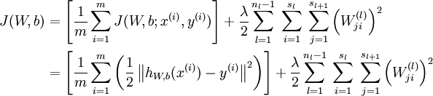
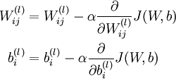
Training
Minimize cost function
Squared error
For a single sample
Overall cost function
Update W,b as:
Notes:
编辑公式

Slide 26
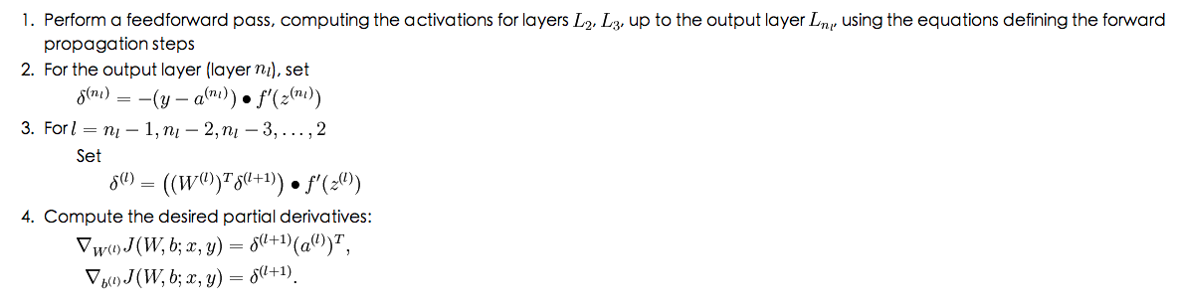
Back propagation
Notes:
http://deeplearning.stanford.edu/wiki/index.php/Backpropagation_Algorithm
画图（动画）示意

Slide 27
Autoencoder and Sparsity

Slide 28
K-NN
k-nearest neighbor

Slide 29
1-NN

Slide 30
K-nn

Slide 31
Index to accelerate searching

Slide 32
Pros & Cons
Non-parameter
Does not make any assumptions on the underlying data distribution
Lazy learning
Does not use the training data points to do any generalization
No training phase, keeps all the training data when predicting
Pros
Easy to understand, easy to implement and debug
Can use the neighbors as explanation
Cons
Large memory requirements
Computationally expensive O(nd)
Curse of dimensionality
"nearest" neighbor might be very far
in high dimensions "nearest" becomes meaningless

Slide 33
Summary

Slide 34
Logistic Regression | parametric | linear
Linear SVM | parametric | linear
Kernel SVM | parametric | Non-linear
Decision Tree | Non-parametric | Non-linear
Random Forest | Non-parametric | Non-linear
Neural Network | parametric | Non-linear
K-Nearest Neighbor | Non-parametric | Non-linear

Slide 35
Reference
Decision Tree
Wiki page
ID3 paper
C45 paper
Breiman, L., J. H. Friedman, R. A. Olshen, and C. J. Stone 1984. Classification and Regression Trees. Chapman and Hall, New York.
《统计学习方法》 第5章
Radom Forest
http://en.wikipedia.org/wiki/Random_forest
Breiman, L. 2001a. Random forests. Machine Learning 45:5-32.
Breiman, L. 2001b. Statistical modeling: The two cultures. Statistical Science 16:199-215.
http://www.stat.berkeley.edu/users/breiman/RandomForests/cc_home.htm

Slide 36
Reference
NN
http://en.wikipedia.org/wiki/Artificial_neural_network
http://deeplearning.stanford.edu/wiki/index.php/Neural_Networks
《Pattern Recognition and Machine Learning》 Chapter 5
Geoff Hinton's Coursera Lectures https://d396qusza40orc.cloudfront.net/neuralnets/lecture_slides%2Flec1.pdf
KNN
http://en.wikipedia.org/wiki/K-nearest_neighbor_algorithm
《统计学习方法》 第3章

